Slide 1
CSC3001 Tutorial 3

Slide 2
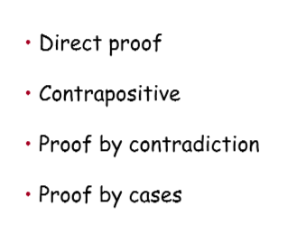

Slide 3
Q1. Prove
If a, b are integers, then a²-4b ≠ 2

Slide 4
Q2. Prove
log23 is irrational.

Slide 5
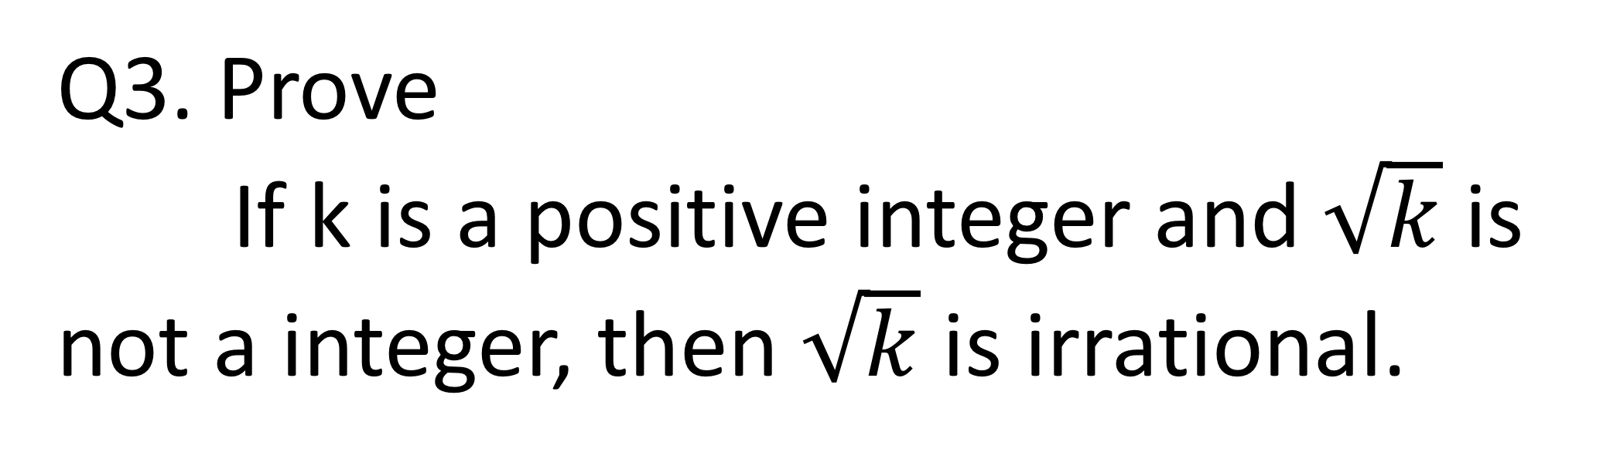
Q3. Prove
If k is a positive integer and$\sqrt{k}$ is not a integer, then $\sqrt{k}$ is irrational.

Slide 6
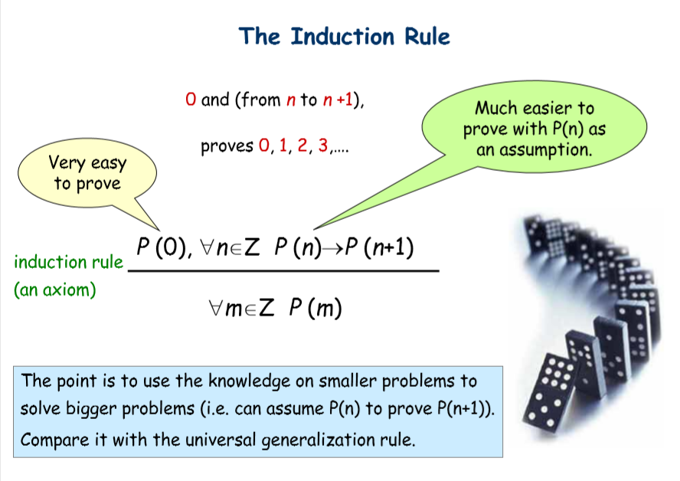

Slide 7
Q4.

Slide 8
Q4.modified
Use mathematical induction to
+
+

